Slide 1
Image Segmentation
with nnUNet
Bishal - 23-05-11

Slide 2
Challenges
I specified nnUNet with 3 class classification but it only used first 2 Classes. [2 Class Classification]
Although this problem can be solved using Modals which nnUNet supports
In this, a total of 4 input files have to be given to nnUNet - originalimage, class1 label, class2 label, class3 label
The input Size for training and inferencing has to be same [same input size]
But, i saw in one if the comments in the issues section of nnUNet that it can be solved using a hacky technique for now.
i will implement the same tomorrow
Number of epochs is set to constant at 1000 epochs [constant epochs]
It takes around 35 hours to complete training
Required 5 fold cross validation to run inferencing [requires 5 fold CV]
This issue was solved by using abstract classes that nnUNet offers and specifying the inferencing manually.
Solved
Unsolved
1

Slide 3
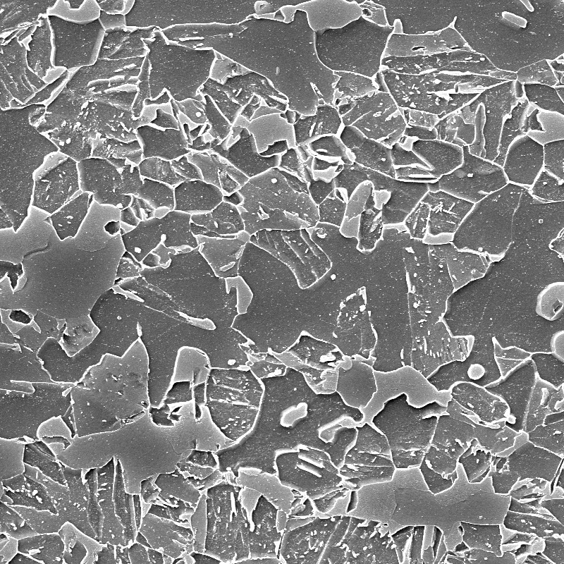
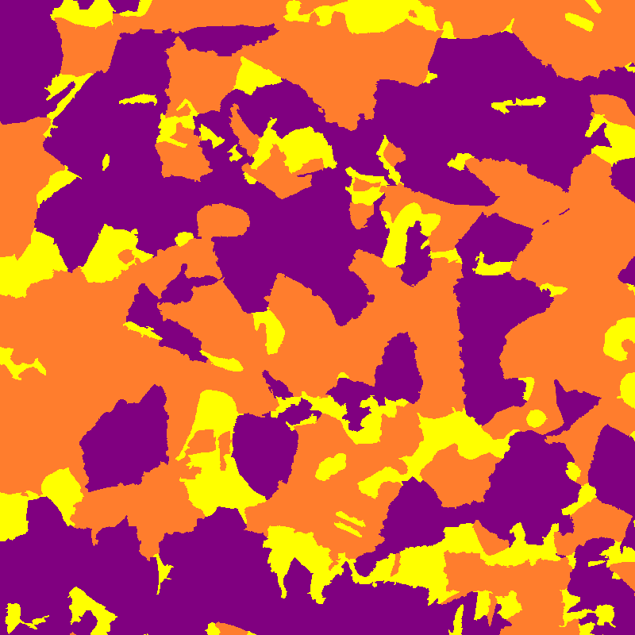
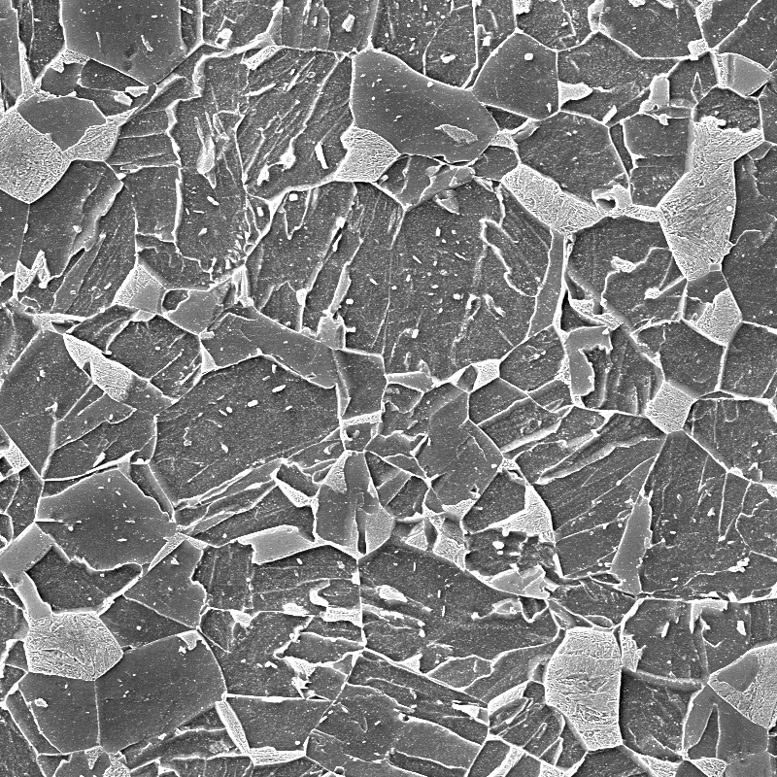
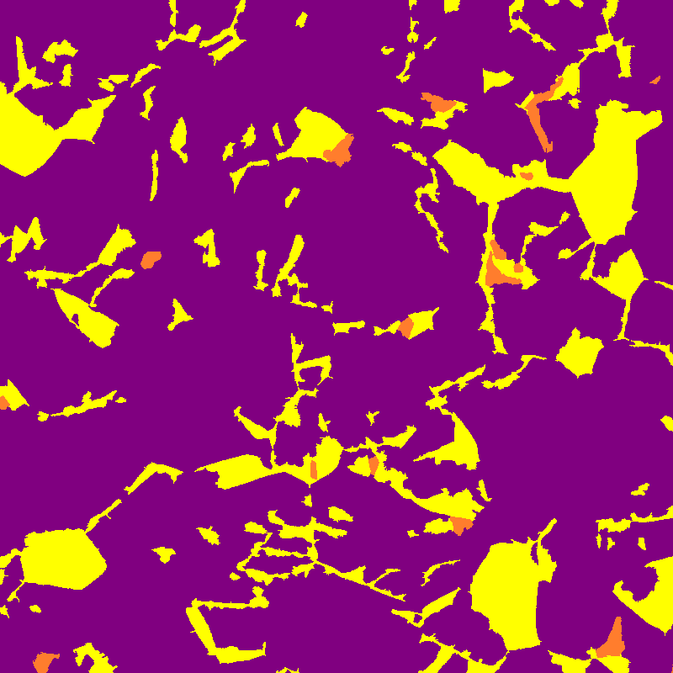
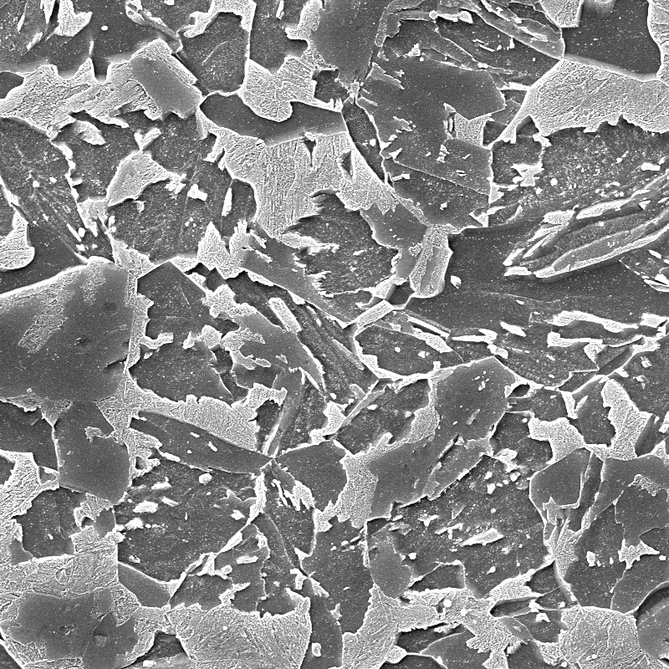
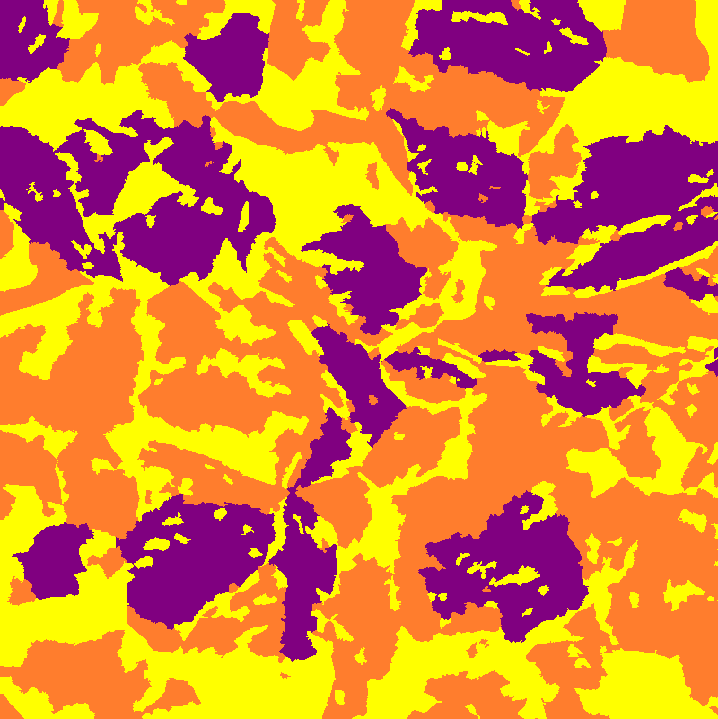
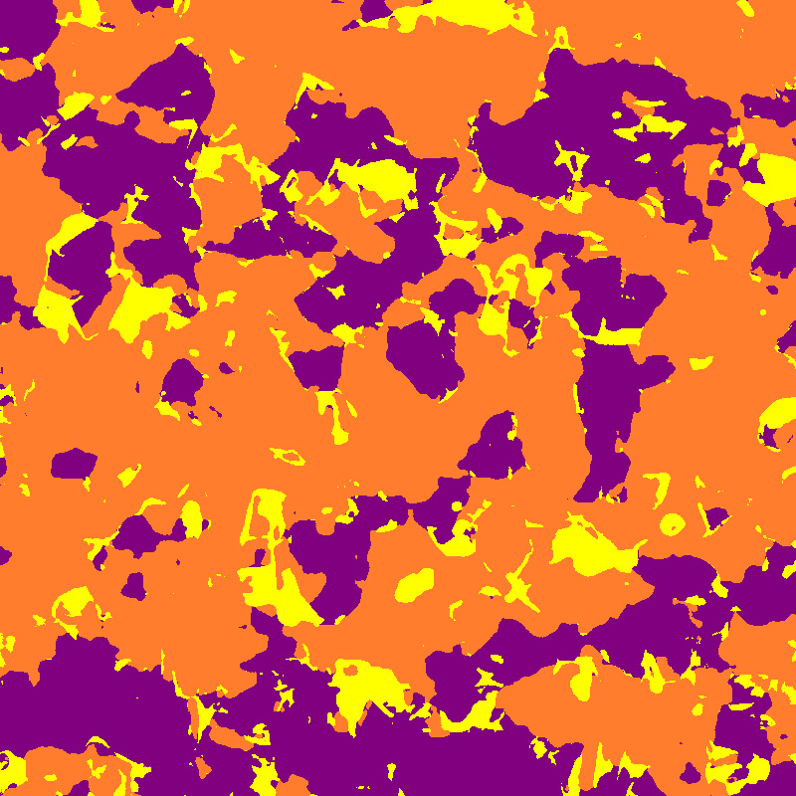
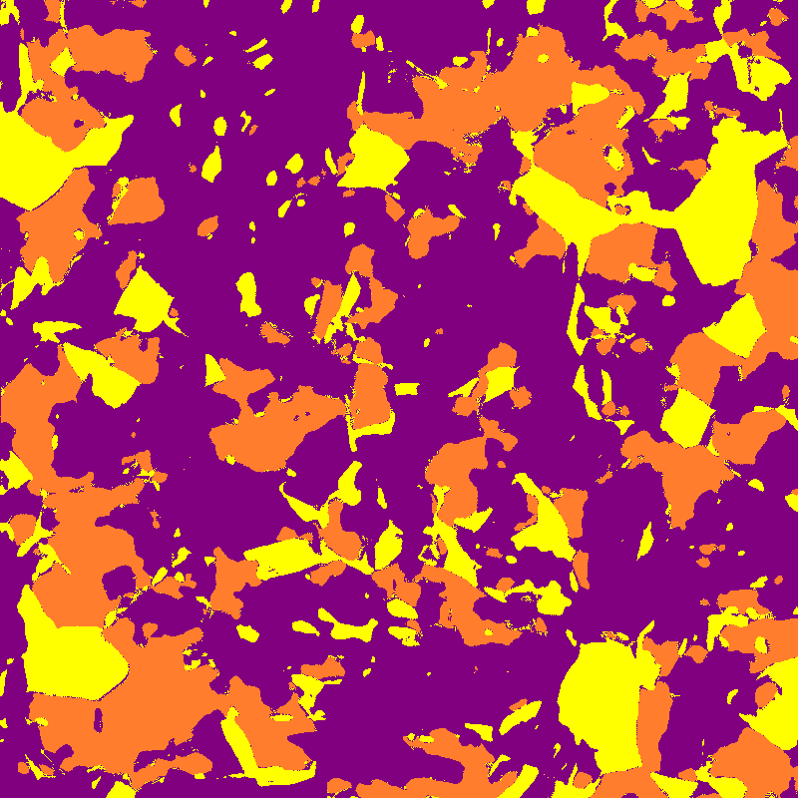
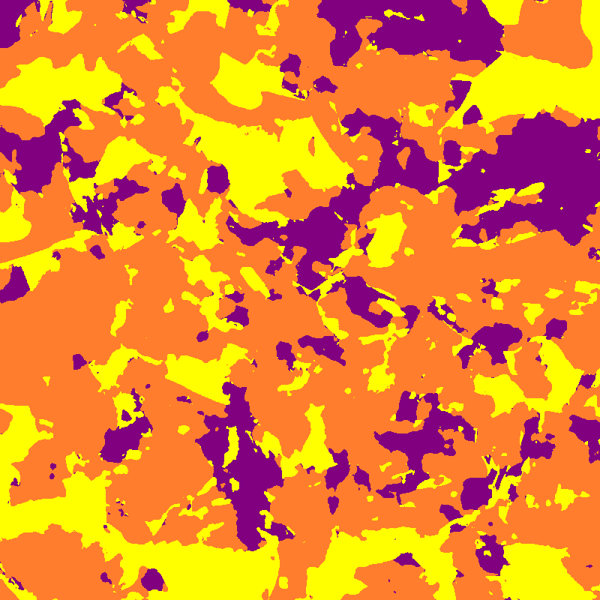
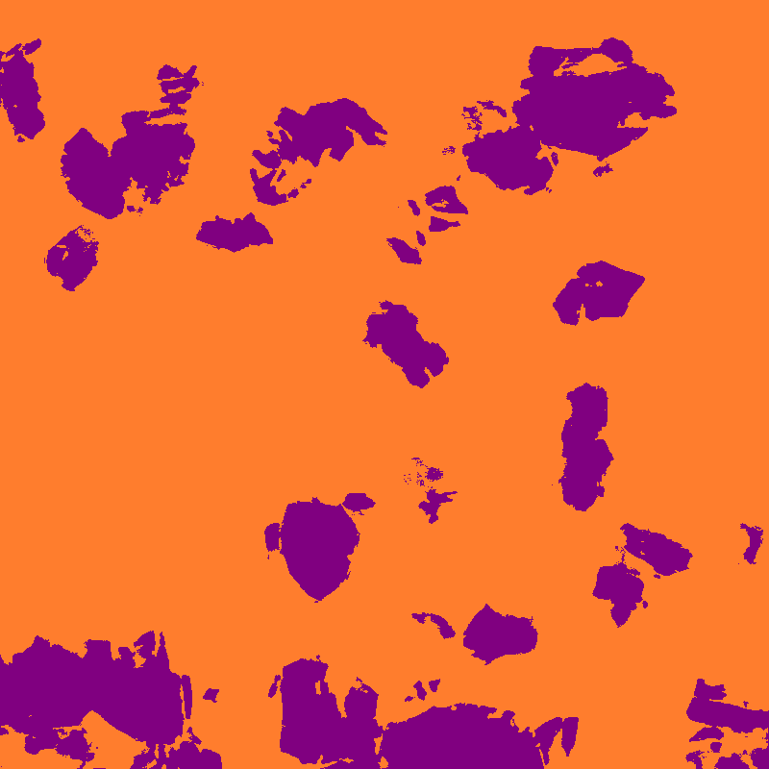
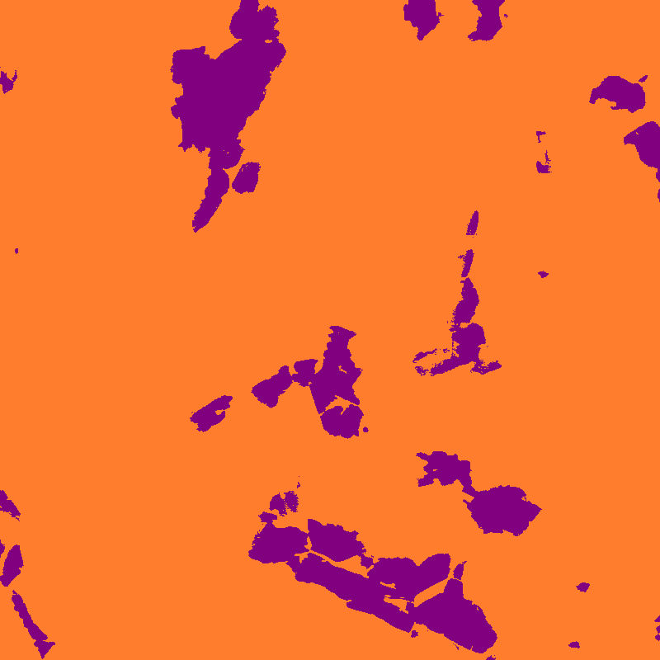
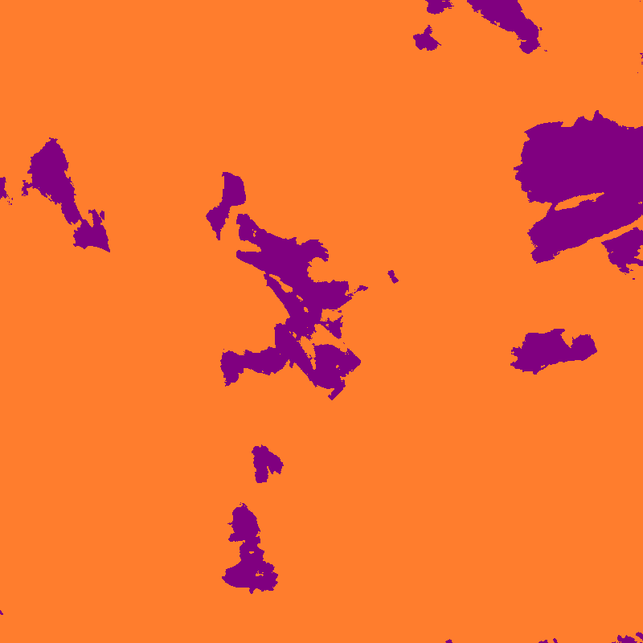
Outputs
800x800 Images
Test1_Atype
Test2_D3type
Test3_H2type
Original
Label
Original
Label
Original
Label
Our Model
Our Model
Our Model
Although its 2 class the model should have classified purple regions but it did not.
nnUNet
nnUNet
nnUNet
2

